Slide 1

SonarQube
Sonar Lint | Detect Code Quality and Security issues on the fly : Developer Friendly
Presented By :
Amrit Choudhary

Slide 2
Pre-Requisites
IntelliJ IDEA or eclipse tool (IDE)
Mac/win laptop
Github account, gitclient
Sonar Lint pluggin installed in the IDE
JDK 1.8+

Slide 3
Sonar Lint Analysis Steps
SonarLint is a free IDE pluggin which helps developer to fix known bugs and vulnerabilities, follow coding standards & best practices.
Provides clear guidance on fixing the code issues before you commit to the source code.
Project is analysed using SonarQube server or SonarCloud whatever your company uses and retrieves the appropriate settings and quality profile for your projects.

Slide 4
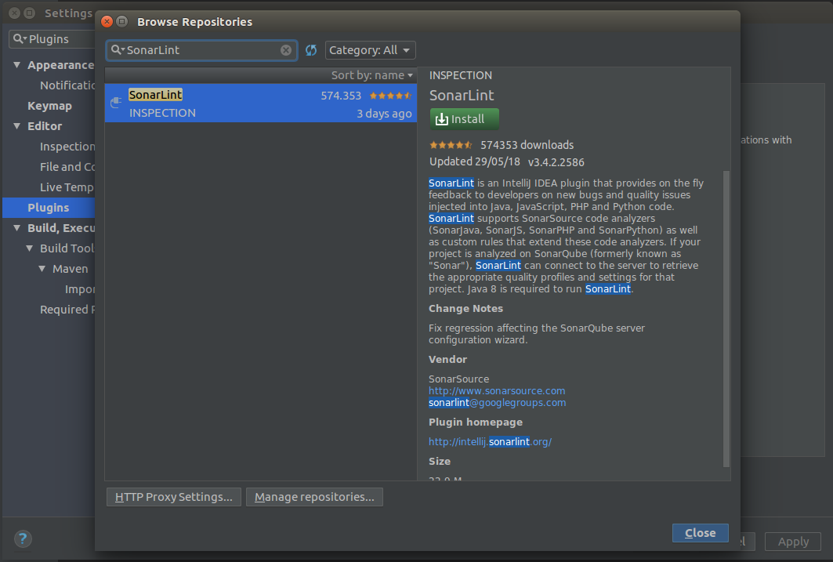
Sonar Lint Plugin

Slide 5
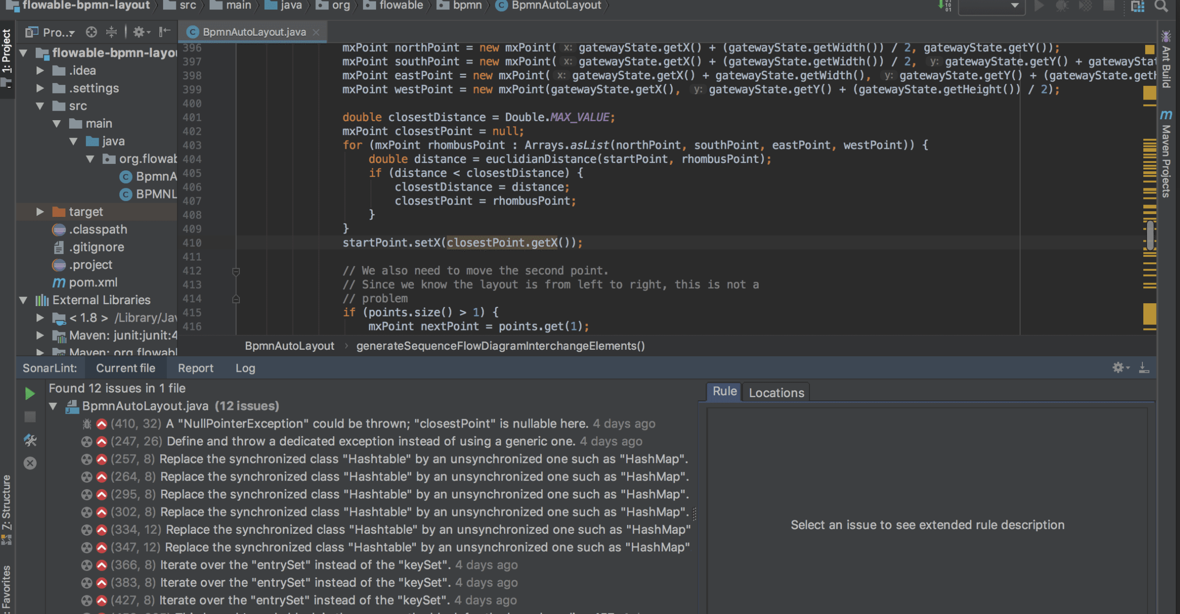
Sonar Lint Analysis

